Slide 1
VSO Volunteer Impact Awards
3rd December 2021
Presented by Christine Ogola and Rene Rayson
#VSOAwards

Slide 2
Agenda
Introductions by Christine Ogola and Rene Rayson
Poem by Yazzie Min, artist, activist and founder of Stand for Humanity
Health Volunteer Award – Presented by Shikha Shrestha, Head of the Inclusive Governance programme, Nepal
Education Volunteer Award – Presented by Boramey Hun, Country Director, Cambodia/Thailand
Break and music by Nisha Chand, Singer Songwriter
Livelihood Award - Presented by Irene Sleven, Head of Partnerships and Programmes, Netherlands
Impact Beyond Volunteering Award presented by Georgie White, Social Media Manager, UK
Music by former Kenyan ICS volunteer Kevin Leteipa aka ‘Leteipa the King’
Closing remarks by Philip Goodwin, Chief Executive of VSO
#VSOAwards

Slide 3
Yazzie Min
Spoken Word Poet
#VSOAwards

Slide 4
Health Volunteer Award Category
Presented by Shikha Shrestha
#VSOAwards

Slide 5
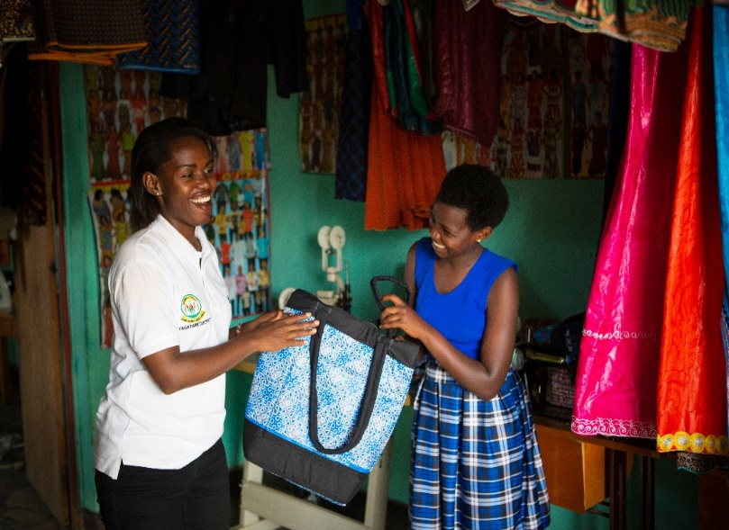
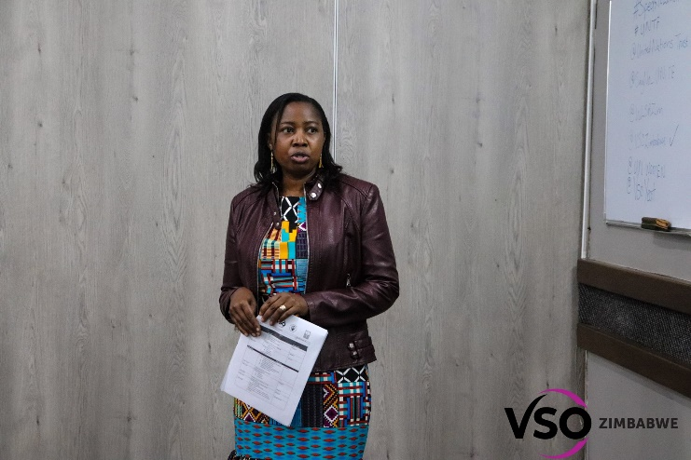
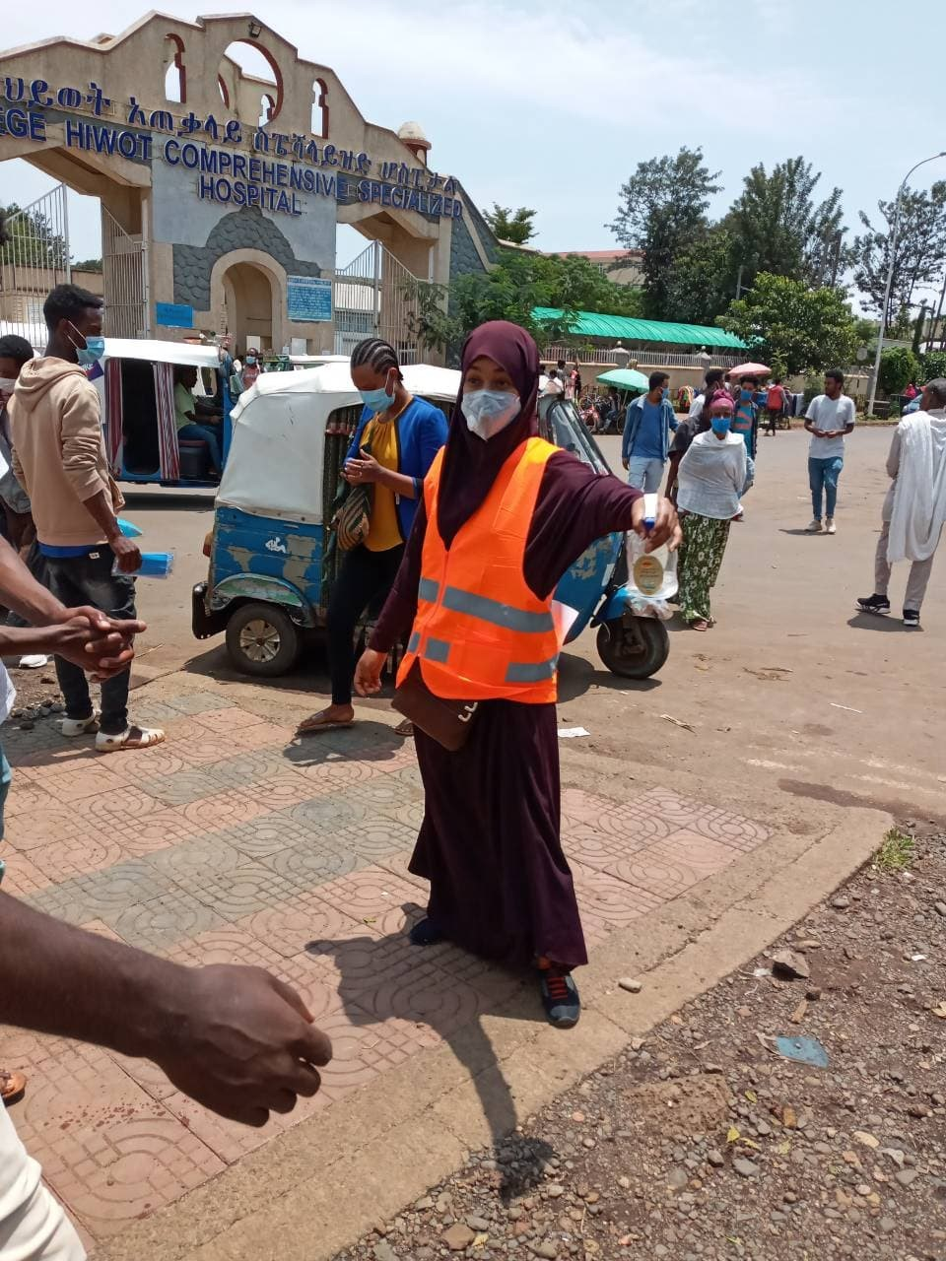
Health Volunteer Award Nominees
Margaret Damba, Zimbabwe
Brown Niyonsaba, Rwanda
Denis Njue, Kenya
Hikma Mekonnen, Ethiopia
#VSOAwards

Slide 6
Health Volunteer Award Winner
Brown Niyonsaba
#VSOAwards

Slide 7
Education Volunteer Award Category
Presented by Boramey Hun
#VSOAwards

Slide 8
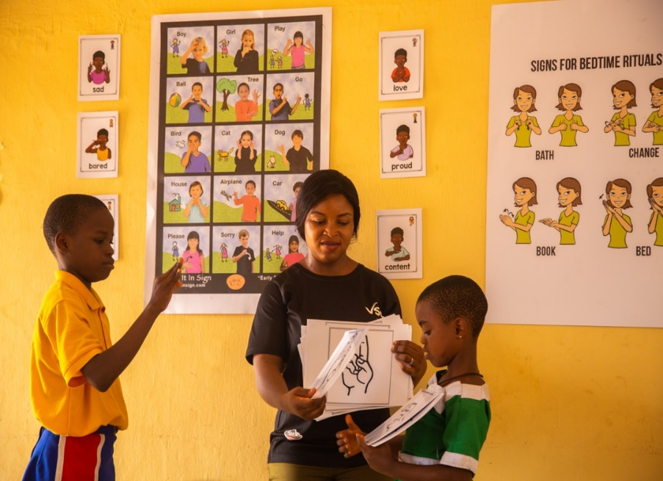
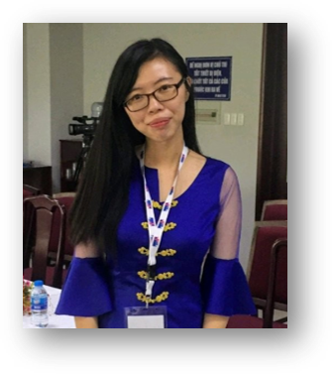
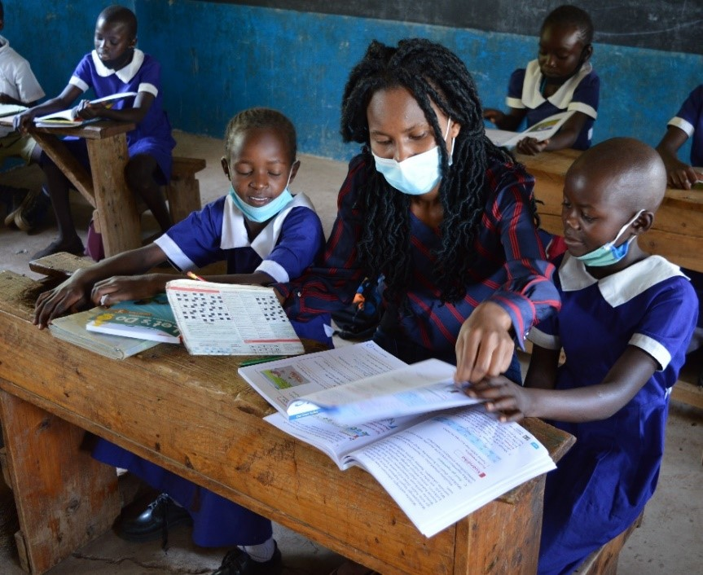
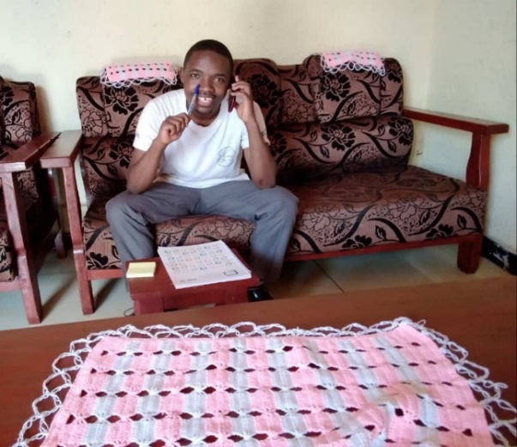
Education Volunteer Award Nominees
Uzoamaka Onyinye Didigwu, Nigeria
Nida Sughra, Pakistan
Yoon Pwint May Thu, Myanmar
Jean Claude Sabato, Rwanda
Lucy Anyango, Kenya
#VSOAwards

Slide 9
Education Volunteer Award Winner
Uzoamaka Onyinye Didigwu
#VSOAwards

Slide 10
Nisha Chand NRG
Music Composer
#VSOAwards

Slide 11
Livelihoods Volunteer Award Category
Presented by Irene Sleven
#VSOAwards

Slide 12
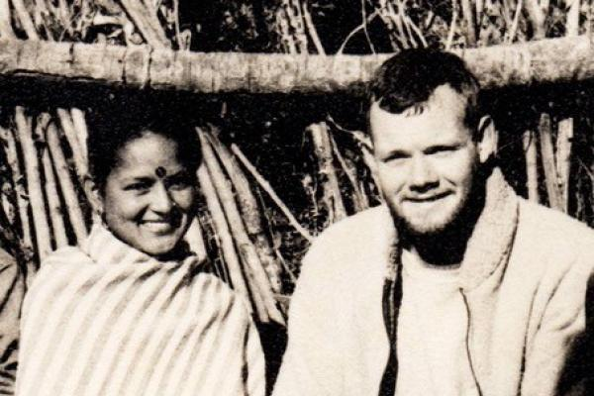
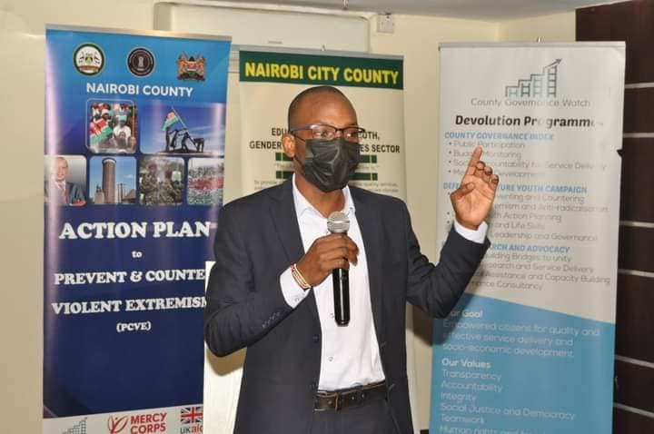
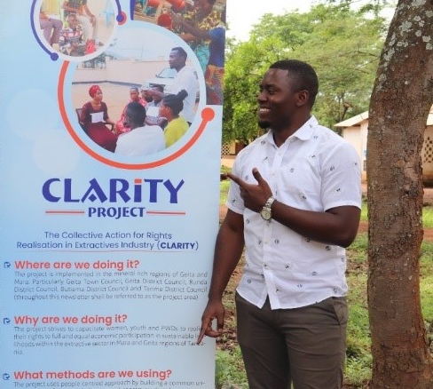
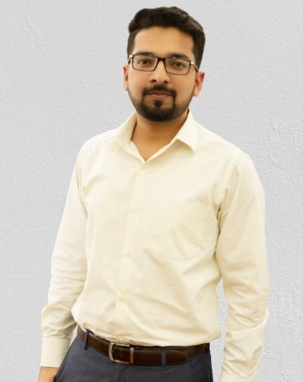
Livelihoods Volunteer Award Nominees
Chris Evans, UK
Evans Otieno, Kenya
Photunatus Nyundo, Tanzania
Muhammad Bilal, Pakistan

Slide 13
Livelihoods Volunteer Award Winner
Evans Otieno
#VSOAwards

Slide 14
Impact Beyond Volunteering Award Category
Presented by Georgie White
#VSOAwards

Slide 15
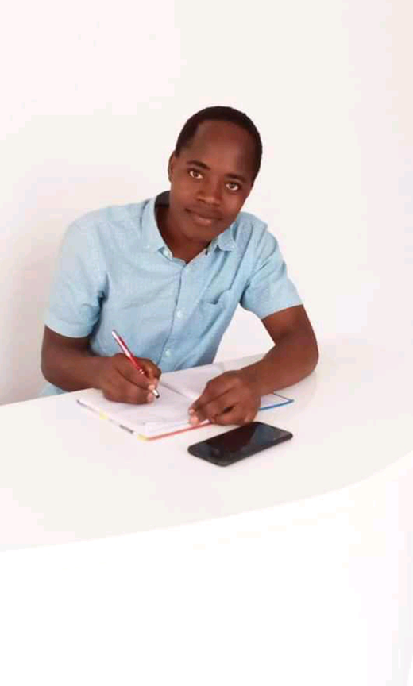
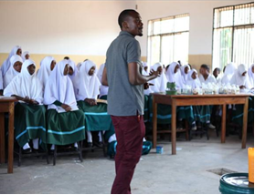
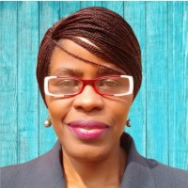
Impact Beyond Volunteering Award Nominees
Ummul Khayer Fatima Bangladesh
Mwarabu Adam , Tanzania
Nicholaus Jackson, Tanzania
Jessica Sanyu, Rwanda
Mariam Omar Mahomed, Tanzania

Slide 16
Impact Beyond Volunteering Award Winner
Mwarabu
Adam
#VSOAwards

Slide 17
Kelvin Leteipa
Afro-pop artist and musician
#VSOAwards

Slide 18
Kelvin Leteipa
Afro-pop artist and musician
#VSOAwards

Slide 19
Remarks by Philip Goodwin
#VSOAwards

Slide 20
#VSOAwards

